Slide 1

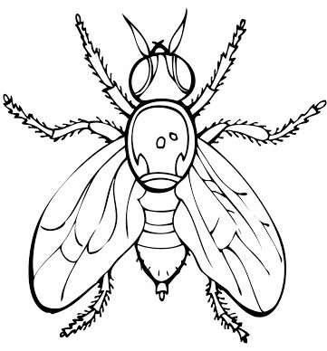
Fruit fly handling
MOLECULAR GENETICS LABORATORY BT344 Experiment (2)

Slide 2
Content
Introduction
Why drosophila?
Life cycle of D. melanogaster
Crossing flies, sexing, killing and maintenance
Basic Drosophila Genetics Nomenclature and Definitions
Procedure
References

Slide 3
Objectives
To familiarize you with an important model organism, the fruit fly, Drosophila melanogaster.
Construct crosses of wild- type and mutant flies and observe the phenotype of their offspring.
Learn techniques to anesthetize flies, kill them and determine their sex.
Learn culturing techniques to keep the flies healthy.

Slide 4
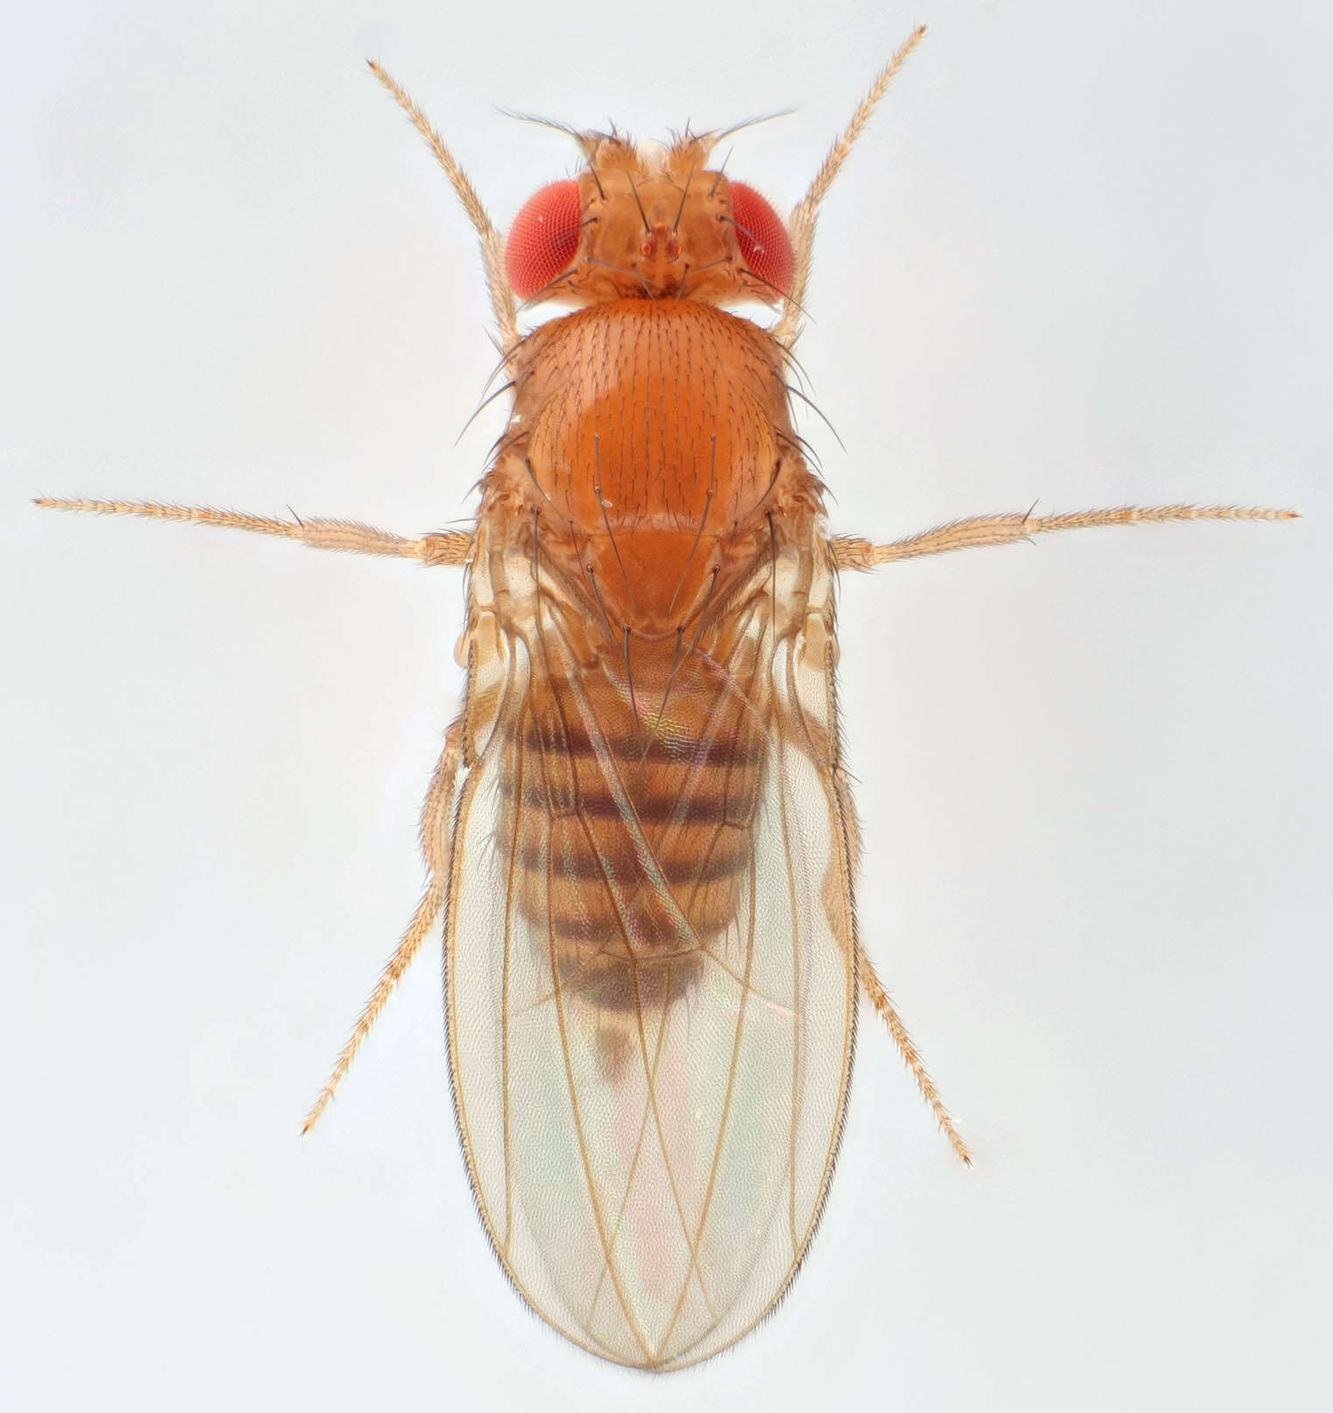
Introduction
Drosophila melanogaster is a small, common fly found near unripe and rotted fruit. It has been in use for over a century to study genetics and behavior.
Thomas Hunt Morgan was the preeminent biologist studying Drosophila early in the 1900’s. He was the first to discover sex-linkage and genetic recombination, which placed the small fly in the forefront of genetic research.
Due to its small size, ease of culture and short generation time, geneticists have been using Drosophila ever since.

Slide 5
Why drosophila?
Part of the reason is historical; so much is already known about it.
2. They are small and easily handled.
3. You can anesthetize them easily and manipulate individuals with much unsophisticated equipment.
4. Drosophila are sexually dimorphic (males and females are different), making it quite easy to differentiate the sexes.

Slide 6
Why drosophila?
5. It is easy to obtain virgin males and females, as virgins are physically distinctive from mature adults.
6. Flies have a short generation time (10-12 days) and do well at room temperature.
7. The care and culture requires little equipment, is low in cost and uses little space even for large cultures.

Slide 7
Life cycle of D. melanogaster
Drosophila melanogaster exhibits complete metamorphism, meaning the life cycle includes an egg, larval (worm-like) form, pupa and finally emergence as a flying adult.
This is the same as the well-known metamorphosis of butterflies. The larval stage has three instars, or molts.

Slide 8
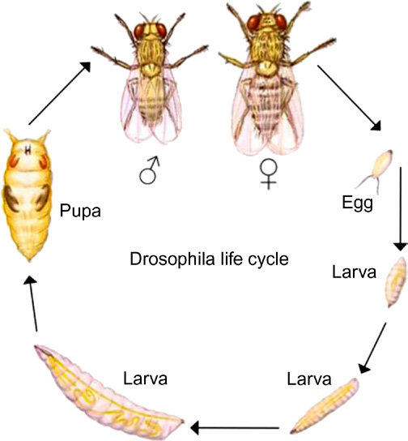
Life cycle of D. melanogaster
1st instar
3rd instar
2nd instar

Slide 9
Life cycle of D. melanogaster
Life cycle by day:
Day 0: Female lays eggs
Day 1: Eggs hatch
Day 2: First instar (one day in length)
Day 3: Second instar (one day in length)
Day 5: Third and final instar (two days in length)
Day 7: Larvae begin roaming stage. Pupation (pupal formation) occurs 120h after egg laying
Day 11-12: Eclosion (adults emerge from the pupa case).

Slide 10
Life cycle of D. melanogaster
Females become sexually mature 8-10 hours after eclosion.
The time from egg to adult is temperature- dependent. The above cycle is for a temperature of about 22°C.
The higher the temperature, the faster the generation time, whereas a lower (to 18 °C) temperature causes a longer generation time.
If your media is white, look for the black area at the head of the larvae.

Slide 11
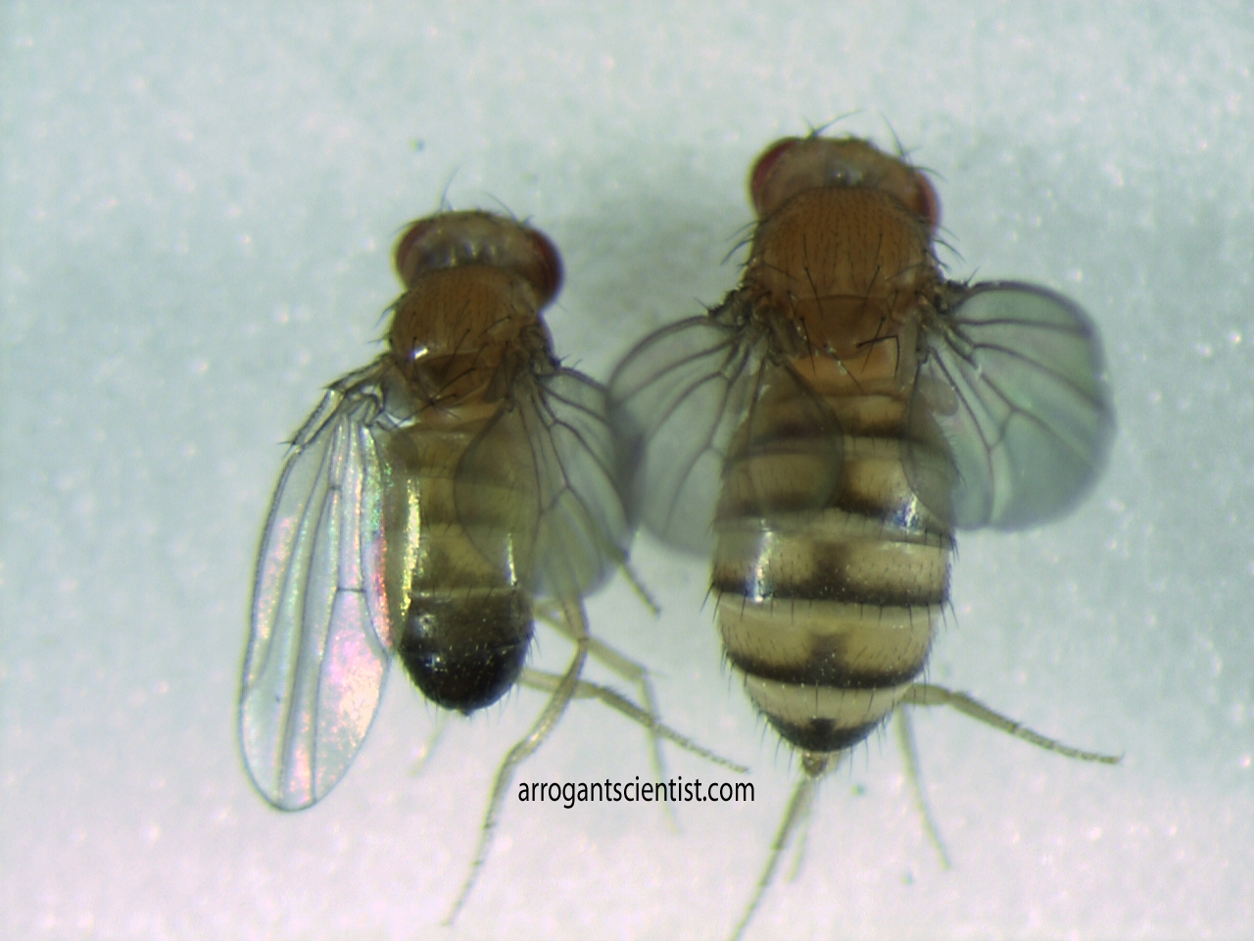
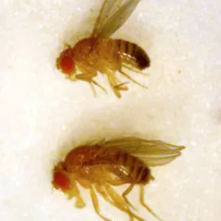
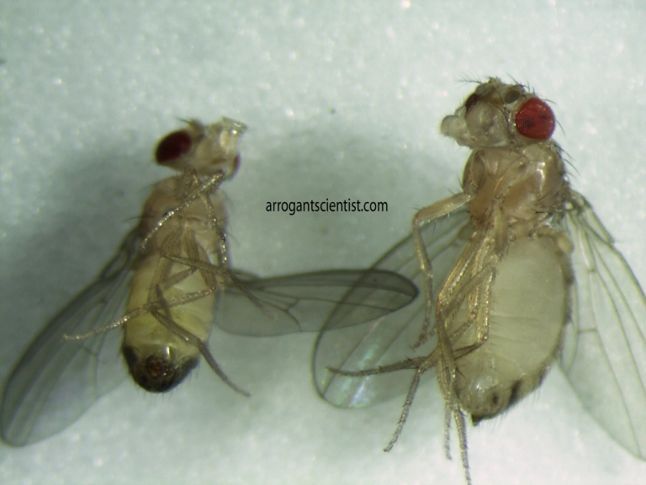
Sexing flies
 | Males | Females
Sex combs | present | Not present
Abdomen tip | Rounded & darker than females | Elongated and pointed
Abdomen Segmentation | 5 segments | 7 segments
Body size | Smaller | Larger

Slide 12
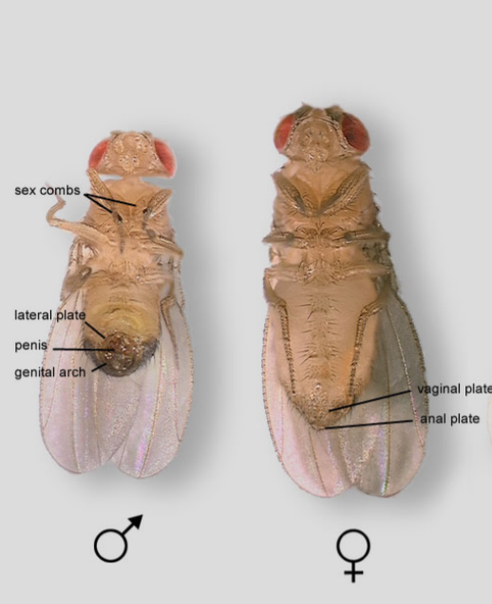
Sexing flies
This figure shows the clear differences in genitalia between male (left) and female (right) flies.

Slide 13
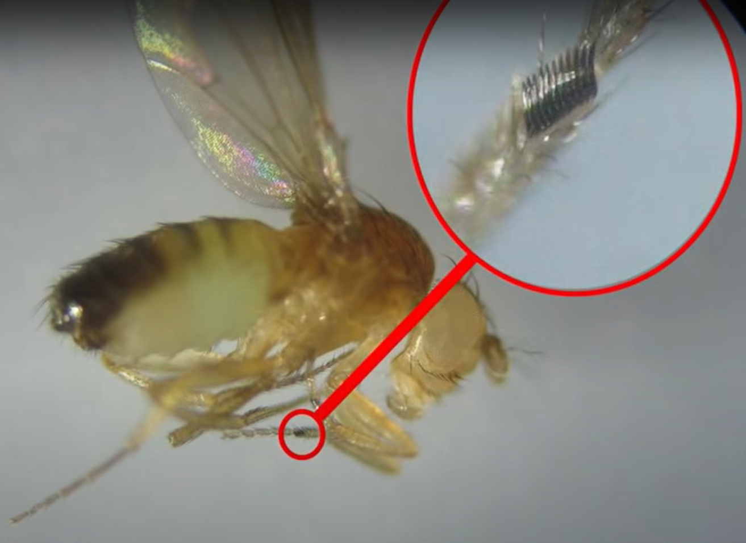
Sexing flies
Sex combs

Slide 14
Collecting virgin females
Females remain virgins for only 8-10 hours after eclosure and must be collected within this time frame.
NOTE: Females can store sperm after a single mating, so if the female for a cross is not a virgin, you will not know the genotype of the male used for your cross.

Slide 15

Collecting virgin females
Virgin females (denoted by the symbol) have several defining characteristics that separate them from mated females:
Very pale .
2. Dark spot seen in abdomen (the meconium, waste products remaining from pupation).
3. Distended, large abdomen Note that very young, newly eclosed, females can have their wings folded and the abdomen may not have inflated yet.

Slide 16
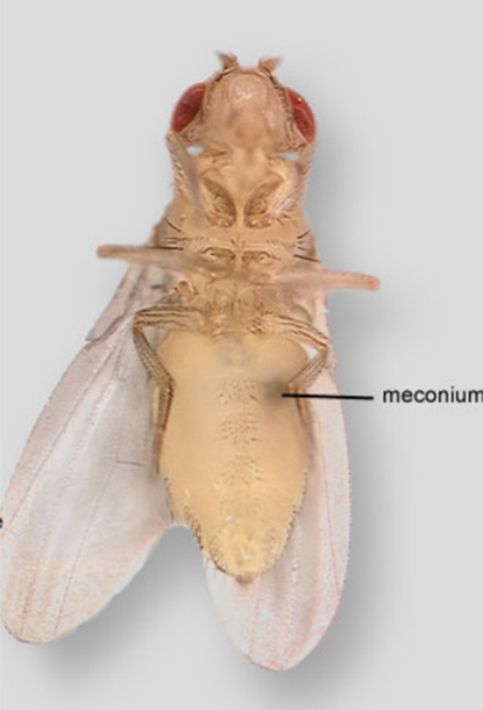
NOTE: One of the best indicators for a virgin female is the presence of the meconium in the gut.

Slide 17
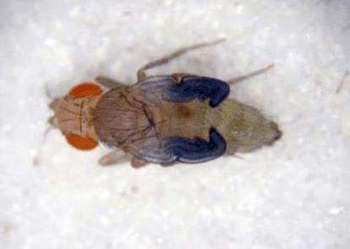

Slide 18
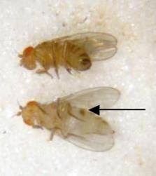
Comparison between a mature (top) and virgin (bottom) female.

Slide 19
Crossing flies
Generally, males will mate more efficiently if they have matured 3 days or longer.
Be sure to select robust, healthy males; the older the flies, the lower the mating efficiency.
Mating occurs quickly and females begin laying fertile eggs soon after mating.
Remove adults once it has been established that enough larvae are present since you may not be able to distinguish parents from the F1 generation.

Slide 20
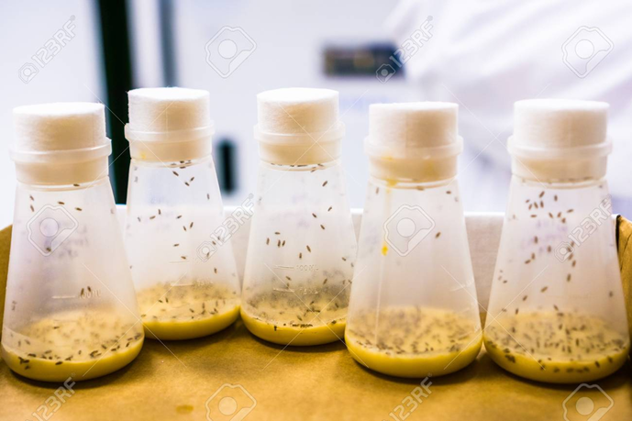
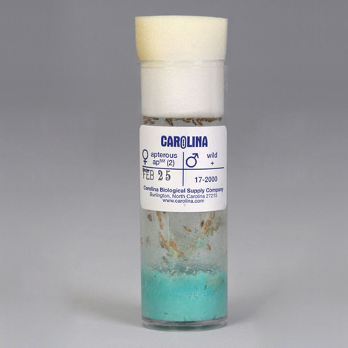
Bottles and vials
For ease of culturing and transferring cultures, uniform bottles and vials are the best approach.
Bottles → for the maintenance of large populations of flies.
vials → for maintaining smaller populations and are the preferred container for constructing student crosses.

Slide 21
Media
There are a variety of types of food available for the flies; some require cooking and others are bought already prepared and dehydrated.
Flies may be added minutes after media has been hydrated.
Cooked media can be stored in a refrigerator for several weeks.
Be sure to allow media to warm to room temperature before adding flies.

Slide 22
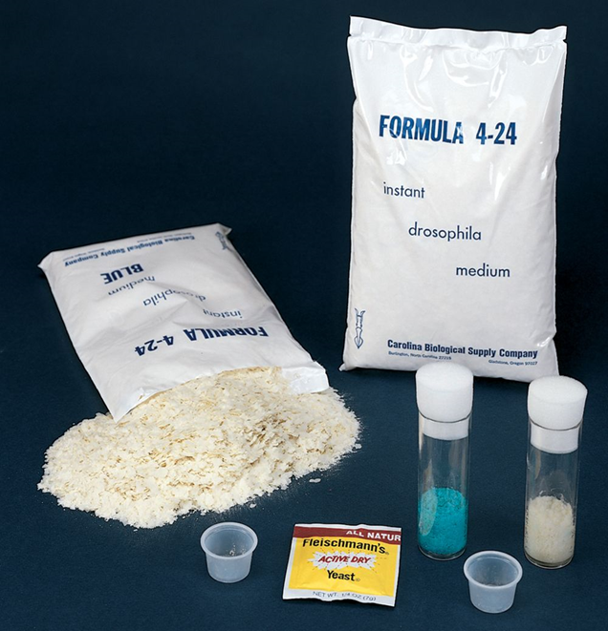
Media
Do NOT allow media to dry out.
Media should fill the culture vial, bottle or vial 1/5th to 2/5th full.

Slide 23
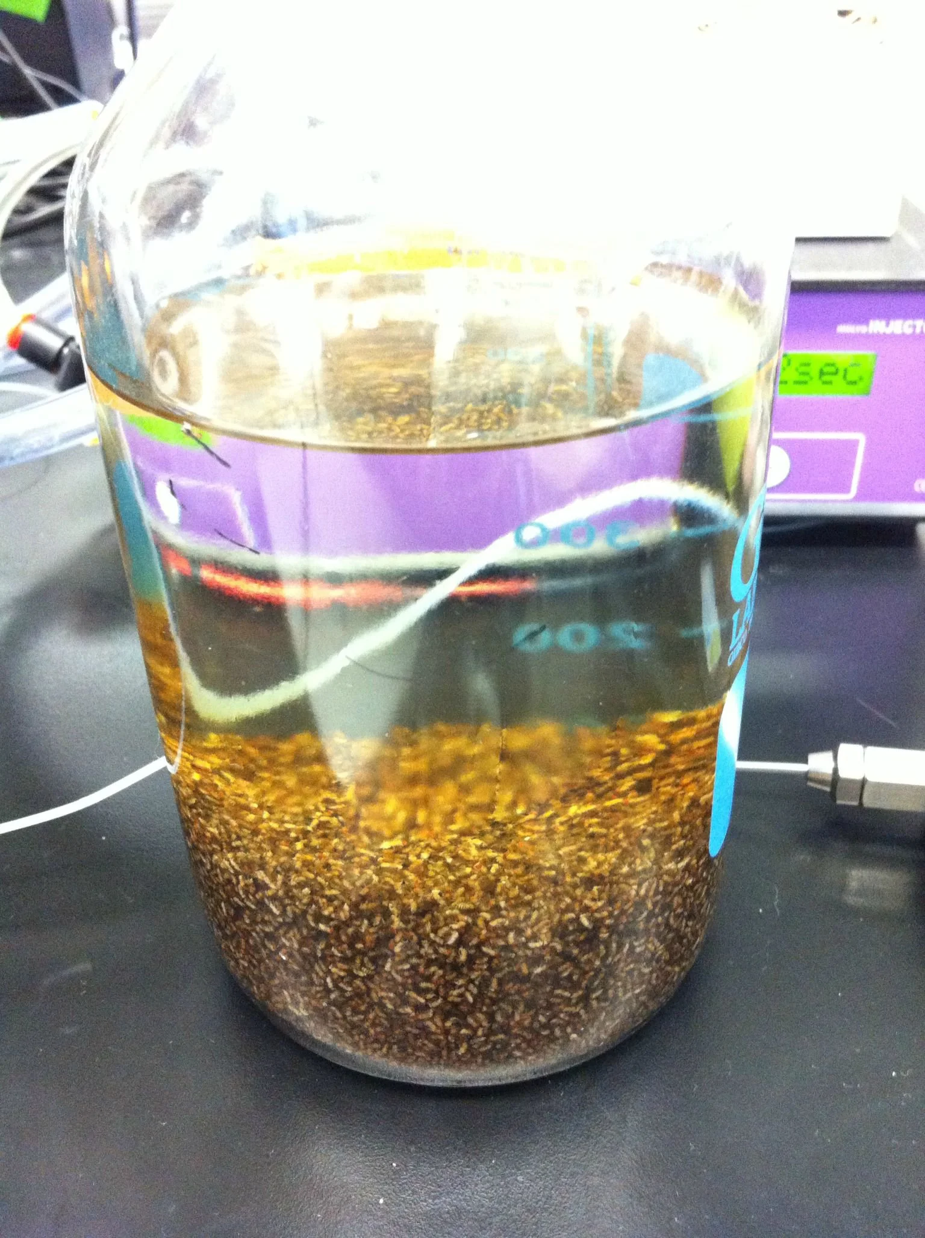
Killing Flies: The Morgue
A bottle or beaker with soapy water is generally used.
Dump anesthetized flies directly into the soapy water where they drown.
A bottle (beaker, or screw-capped jar) filled with ethanol or isopropanol can also be used as a morgue.

Slide 24
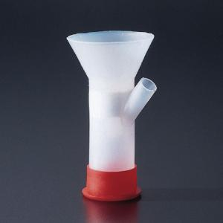
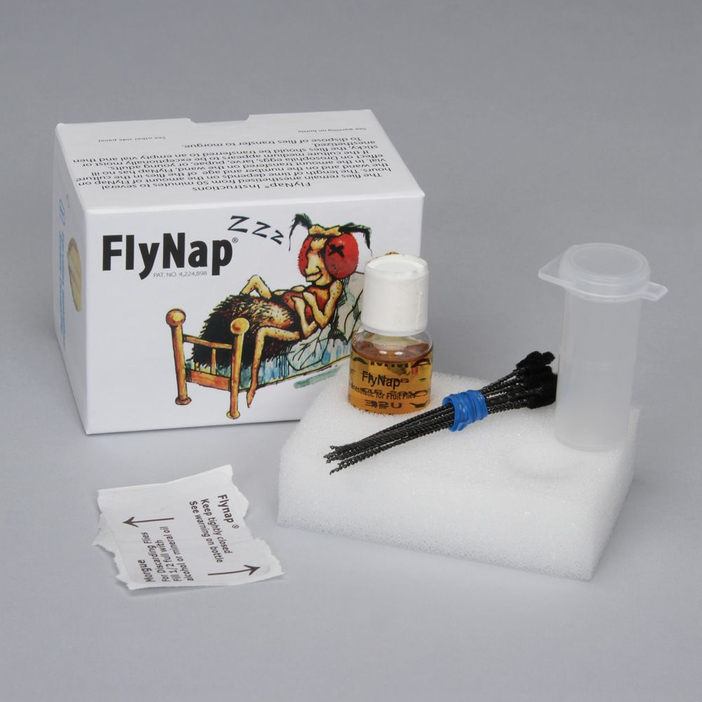
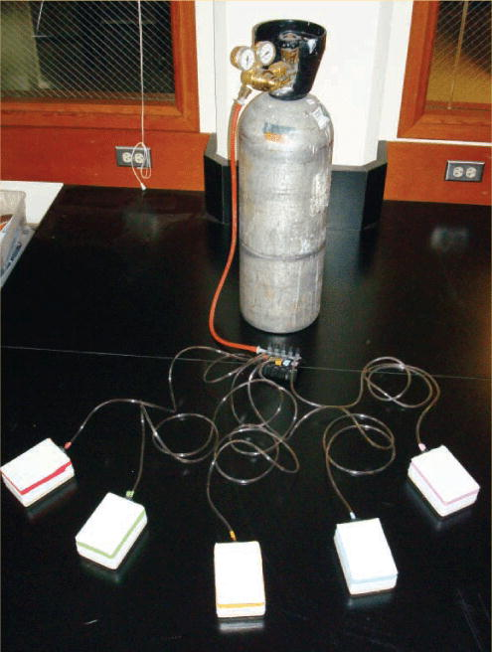
Anesthetizing flies
Ether
FlyNap
Co2

Slide 25
Basic Drosophila Genetics Nomenclature and Definitions
Drosophila melanogaster flies have 4 chromosomes (4 pairs):
Sex chromosomes
chromosome II
chromosome III
chromosome IV
Wild-type is denoted as “+” or WT.
Dominant mutations are written with a capital letter( example: Bar or B).
Recessive mutations are written with a lower-case letter (For example: white or w).

Slide 26
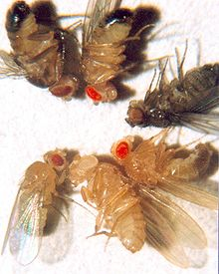
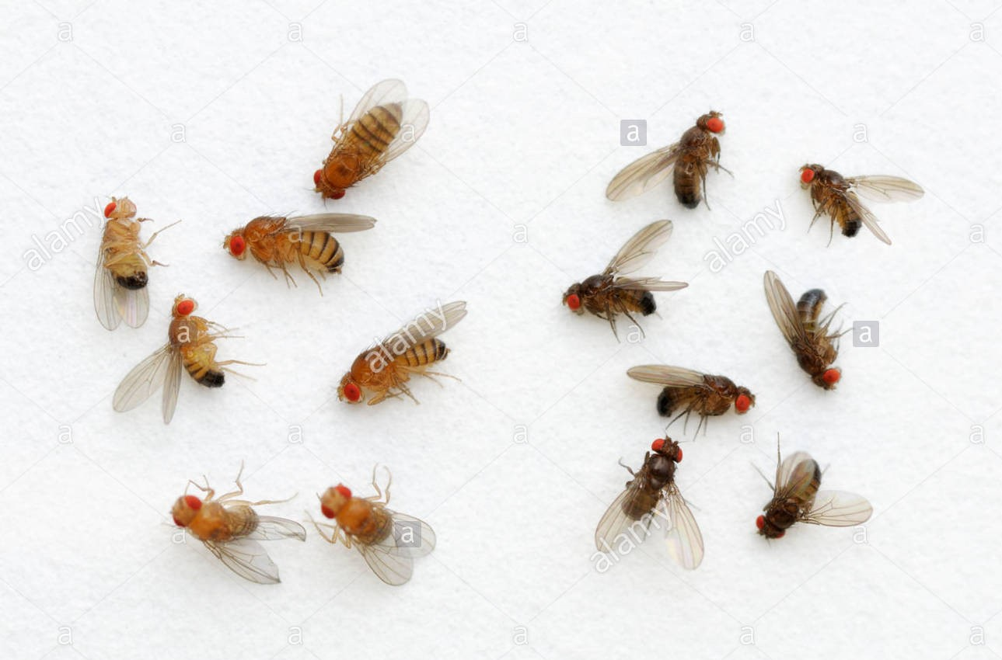
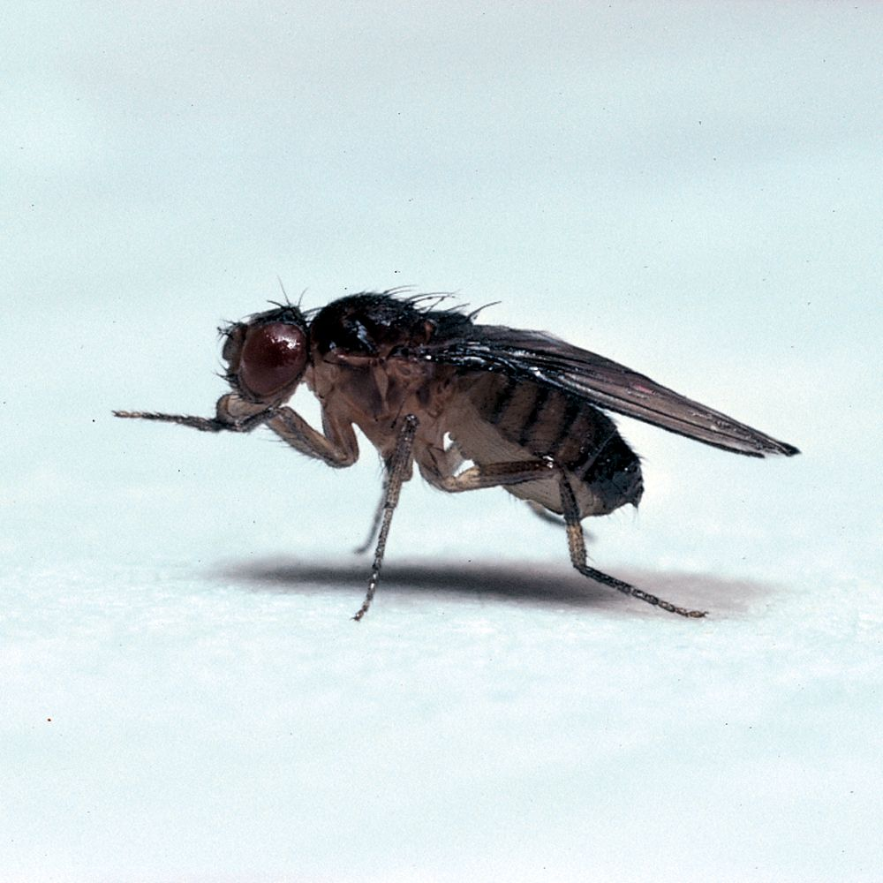
Basic Drosophila Genetics Nomenclature and Definitions
Any fly exhibiting a phenotypic mutation is called a "mutant".
Mutant flies are given names that generally denote the type of mutation the fly exhibits.
For example, the recessive mutant "ebony" has a much darker body than the wild type fly.

Slide 27
Basic Drosophila Genetics Nomenclature and Definitions
Each mutation is also given a letter code. Thus, in the case of ebony, the code is a lower-case e.
The wild type fly is denoted by a superscript + over the mutant letter code.
For example, e+ denotes a wild type fly for the ebony body trait - meaning it has normal body color (not ebony).

Slide 28
Basic Drosophila Genetics Nomenclature and Definitions
If the gene is located on a sex chromosome, we use a slightly different notation.
Under normal diploid conditions a female fruit fly has two X chromosomes; a male has an X and a Y chromosome.
Sex-linked genes are located on one of the sex chromosomes (usually the X chromosome).

Slide 29
Basic Drosophila Genetics Nomenclature and Definitions
Thus, the genotypic notation for a mutant gene for white eye color on the X chromosome would look like:
X^{w} X^{w} = white-eyed female
X^{w+}X^{w} = wild type heterozygote female
X^{w} Y = white-eyed male
X^{w+} Y = wild type male

Slide 30
Basic Drosophila Genetics Nomenclature and Definitions
Wild type traits of Drosophila:
1. Reddish-brown eyes with a black round spot.
2. Pale brown (grey) body color with transverse black rings across their abdomen.
3. Long-rounded wings.

Slide 31
Drosophila mutant phenotypes:
Mutations on chromosome I (sex chromosome):
Bar eyes (X^{B}).
White eyes (X^{w}).
Yellow body (X^{y}): yellow body color with no black segments.
Cross vein-less wings (X^{cv}): no cross veins.

Slide 32
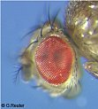
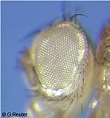
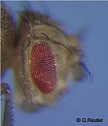
Drosophila mutant phenotypes:
WT
white
Bar

Slide 33
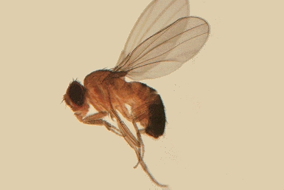
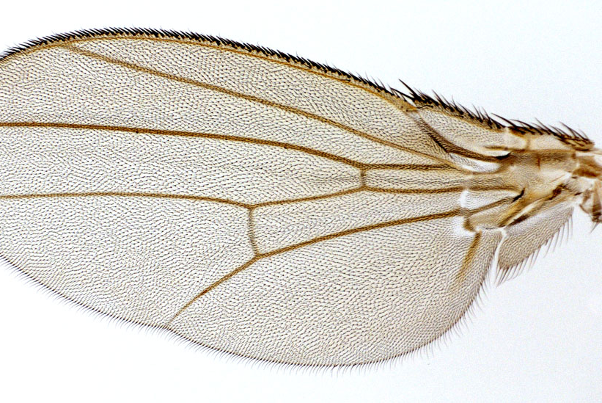
Drosophila mutant phenotypes:
Cross vein-less wings
WT

Slide 34
Drosophila mutant phenotypes:
Mutations on Chromosome II:
Black body color (b).
Vestigial wings (vg): shortened wings. Flies cannot fly.
Dumpy wings (dp): wings reduce to 2/3 their normal length with about the length of the body.
Apterous (ap): wingless flies.
Curly wings (Cy): wings are not straight (Lethal when homozygous).

Slide 35
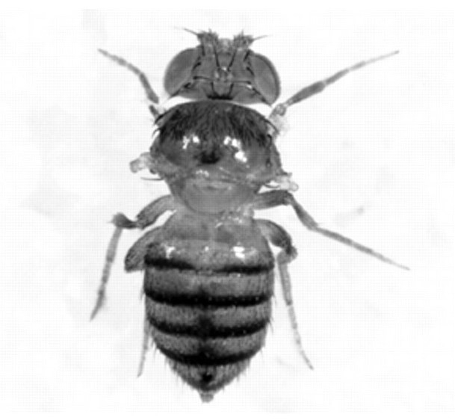



Drosophila mutant phenotypes:
Apterous
Curly wings
Vestigial
WT

Slide 36
Drosophila mutant phenotypes:
Mutations on chromosome III:
Ebony (e): darker body color.
Scarlet eyes (st): eyes are reduced in size with brighter red color and the absence of the black spot.

Slide 37
Drosophila mutant phenotypes:
Mutations on chromosome IV:
Eyeless (ey): flies develop with no eyes.
Stubble bristles (Sb): produces short bristles.
Lethal gene: a gene that influences viability.

Slide 38
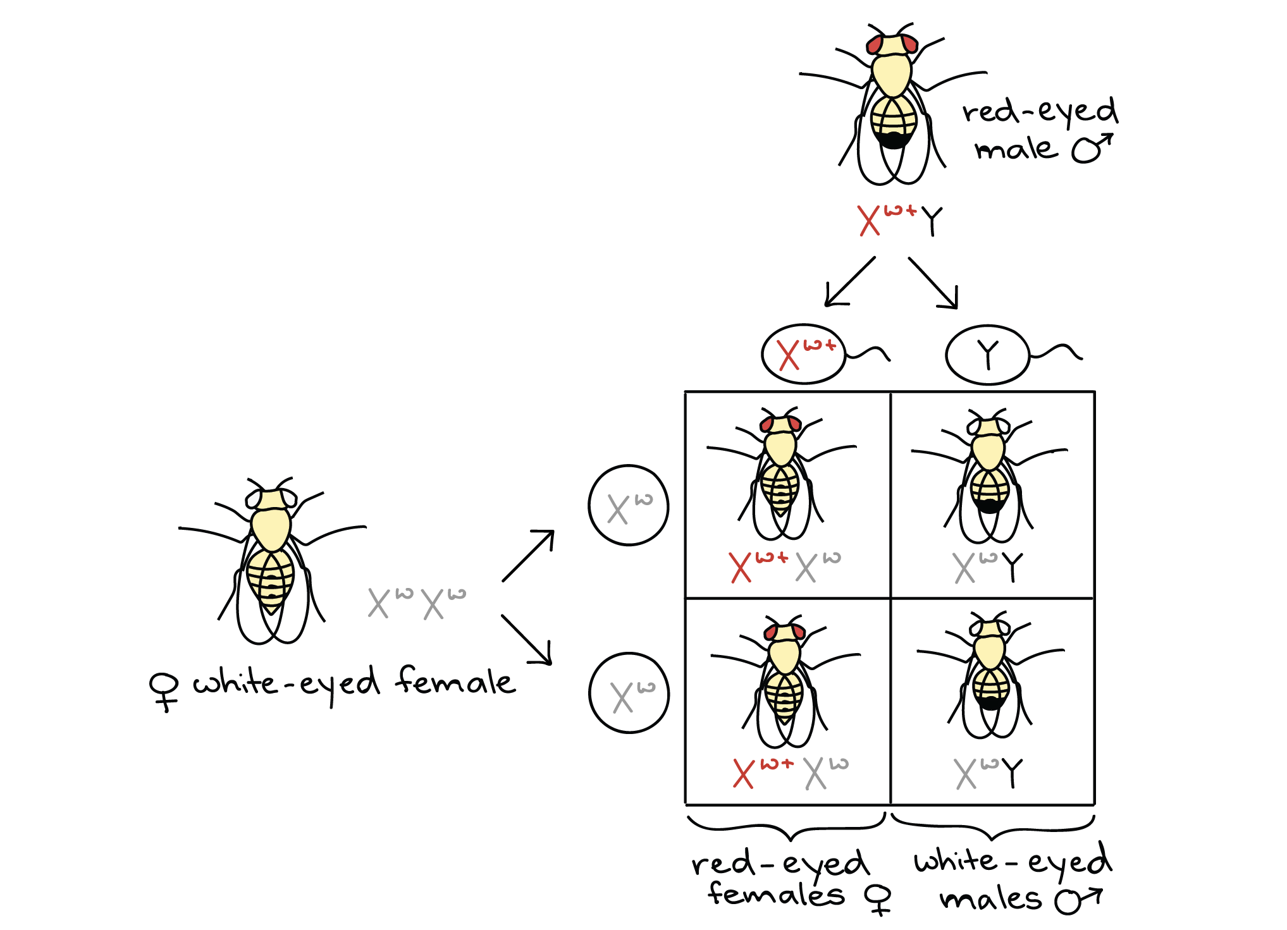
Genetic cross (monohybrid)

Slide 39
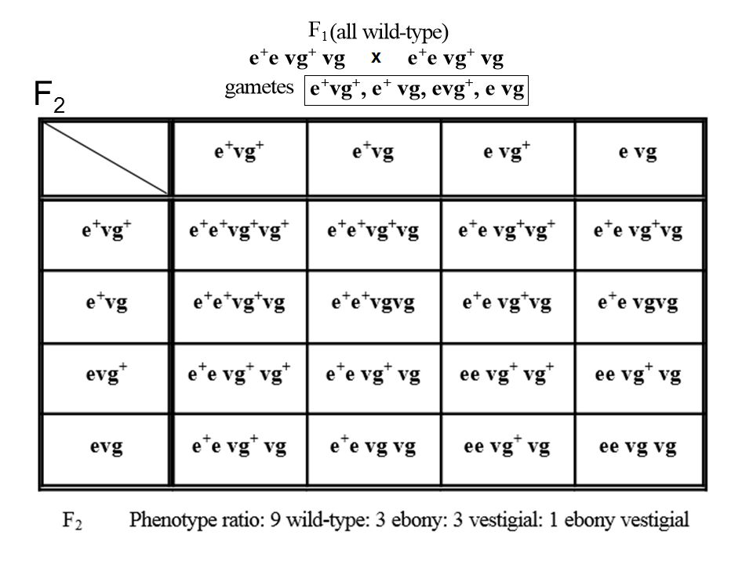
Genetic cross (dihybrid)

Slide 40
Procedure
Preparing fly food:
1- Weigh 1 g Drosophila instant media in a weighing boat, and place in a plastic vial.
2- Add 5 ml autoclaved distilled water to the vial and mix vigorously.
3- Sprinkle a little bit of dried yeast into the top of the media.

Slide 41
Procedure
Anesthetizing the flies:
1- Open the plastic funnel and add 2-3 drops of ether to the cotton inside it. DO NOT INHALE THE ETHER.
2- On your bench, tap the vial that contains the flies and quickly open the plug and put the opening of the plastic funnel in place of the plug.
3- Held together, turn the funnel and the vial upside down and tap the funnel on the bench until all the flies are inside the funnel.
4- Wait for 15 seconds and then open the funnel and place the flies on the stage plate.

Slide 42
Procedure
Maintaining the flies:
1- Under the dissecting microscope separate 4 males and 4 females and put them in the media vial you prepared.
2- Keep the vial horizontally until the flies awake.
3- Put the vials in an incubator at 25C.
4- After 4 days, remove the parent flies by anesthetizing and discard them in a morgue.
5- After 10-12 days (or 7 days from killing P), count the first generation, record your results, and separate 4 males and 4 females from the F1 and put them in a new vial.
6- Repeat steps 3+4.
7- After 10-12 days (or from killing F1), , count the second generation, record your results. 7 days

Slide 43
References
An introduction to fruit flies. (2017, July 11). Retrieved March 03, 2021, from http://depts.washington.edu/cberglab/wordpress/outreach/an-introduction-to-fruit-flies/
https://www.researchgate.net/figure/The-life-cycle-of-Drosophila-melanogaster-Drosophila-exhibit-a-10-day-life-cycle-at_fig41_315866219
https://www.carolina.com/flies/flynap-anesthetic-kit/173010.pr
https://www.tritechresearch.com/MINJ-DROS-FP.html
https://www.biologie.uni-halle.de/entwicklungsgenetik/lehre/studenten/drosophila/mutanten/?lang=en
https://www.medicalimages.com/stock-photo-photomicrograph-of-an-ebony-fruit-fly-variant-drosophila-sp-with-a-black-body-mag-105x-at-6-image22441070.html
https://www2.le.ac.uk/departments/genetics/research/staff-research-interests/tauber-research-lab/livegene/fly-manual-1#:~:text=The%20most%20simple%20characteristic%20to,females%20have%20light%2C%20pointed%20genitalia.

